Slide 1
Traffic light controller system for four-way intersection
19ECE341 – VLSI System Design
K.D V N B Arun Kumar – CB.EN.U4ECE19024
Srirangam Sai Teja – CB.EN.U4ECE19051
Group Id: AG9

Slide 2
INTRODUCTION
Roads without any supervision or guidance can lead to traffic conflicts and accidents. Traffic signals are required for an orderly flow of traffic.
A traffic signal is used as an instructing device that indicates the road user to act as per the displayed sign.
Traffic lights allow everyone to cross the intersection point one by one, reducing conflicts between vehicles entering intersection points from different directions.
It provides road safety, also helps to solve traffic in simple manners.
Different types of traffic controllers can be designed for any intersection. We designed an efficient controller which includes always free left case and emergency case.

Slide 3
METHODOLOGY
Each road has three light displays corresponding to the flow of traffic towards the other three roads.
A state diagram and a state table are constructed based on the simplified logic to model a finite state machine for the proposed traffic light controller system.
We designed a finite state machine with 5 states, in which the first state is reset state and remaining 4 states corresponds to 4 directions at intersection.
All these states will be repeated in the designed order and all the states has equal delay so each lane gets equal time for clearing the traffic.
Input was taken through sensor for allowing emergency vehicles.
In emergency case priority was given to emergency vehicles to clear the traffic in that lane.
In our design we included always free left case for all the lanes in order to reduce congestion.

Slide 4
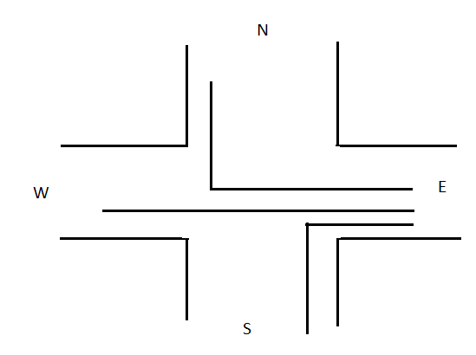
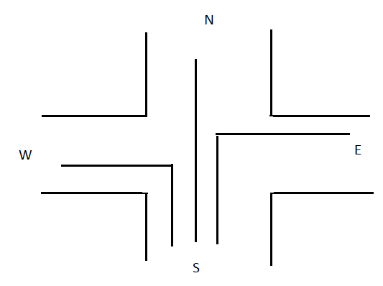
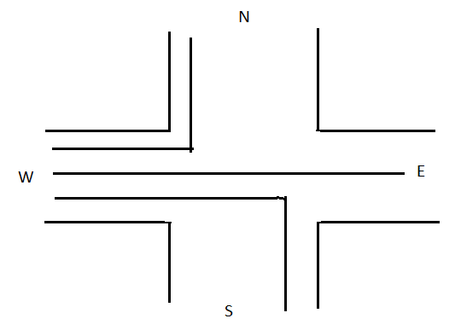
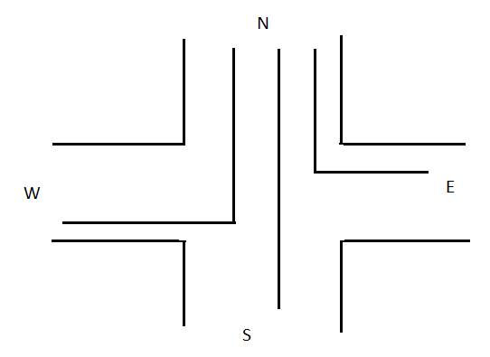

Slide 5
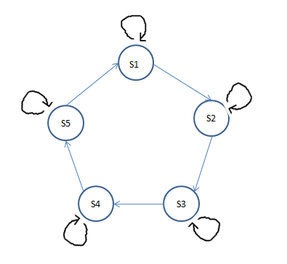
STATE DIAGRAM
S1 – Reset state
S2 – East state
S3 – South state
S4 – West state
S5 – North state

Slide 6
STATE TABLE
Traffic Signal status for each direction
 |  | RYG | RYG | RYG | RYG | RYG | RYG | RYG | RYG | RYG | RYG | RYG | RYG
Present State | Next State | East | East turn | East FL | South | South turn | South FL | West | West turn | West FL | North | North Turn | North FL
000 | 001 | 000 | 000 | 000 | 000 | 000 | 000 | 000 | 000 | 000 | 000 | 000 | 000
001 | 010 | 001 | 001 | 001 | 100 | 100 | 001 | 100 | 100 | 001 | 100 | 100 | 001
010 | 011 | 100 | 100 | 001 | 001 | 001 | 001 | 100 | 100 | 001 | 100 | 100 | 001
011 | 100 | 100 | 100 | 001 | 100 | 100 | 001 | 001 | 001 | 001 | 100 | 100 | 001
100 | 000 | 100 | 100 | 001 | 100 | 100 | 001 | 100 | 100 | 001 | 001 | 001 | 001
000 |  | 000 | 000 | 000 | 000 | 000 | 000 | 000 | 000 | 000 | 000 | 000 | 000

Slide 7
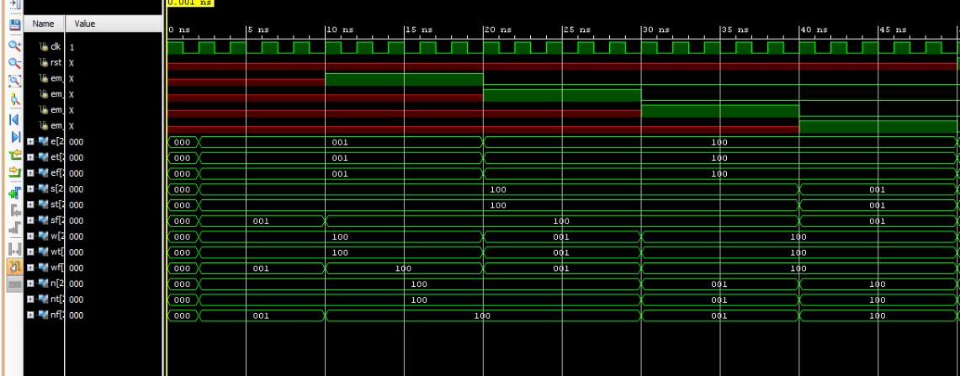
RESULTS
Simulated waveform of the system – Emergency case

Slide 8
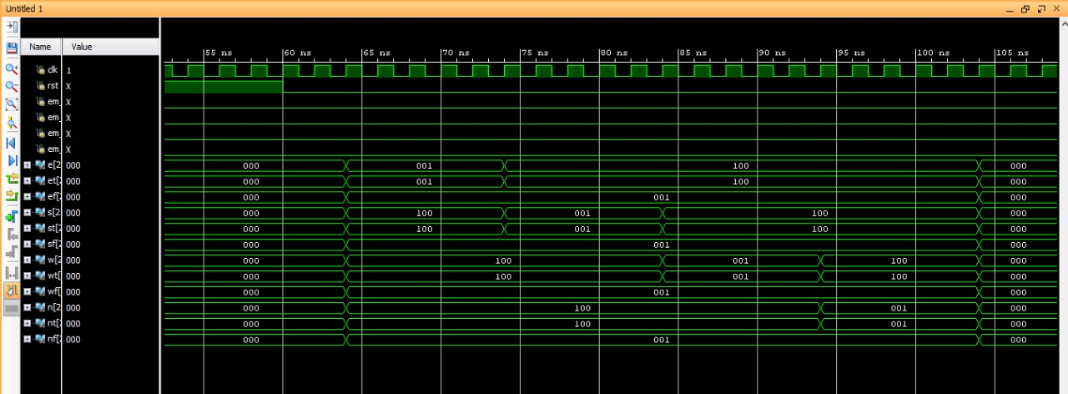
Simulated waveform of the system - Normal Traffic

Slide 9
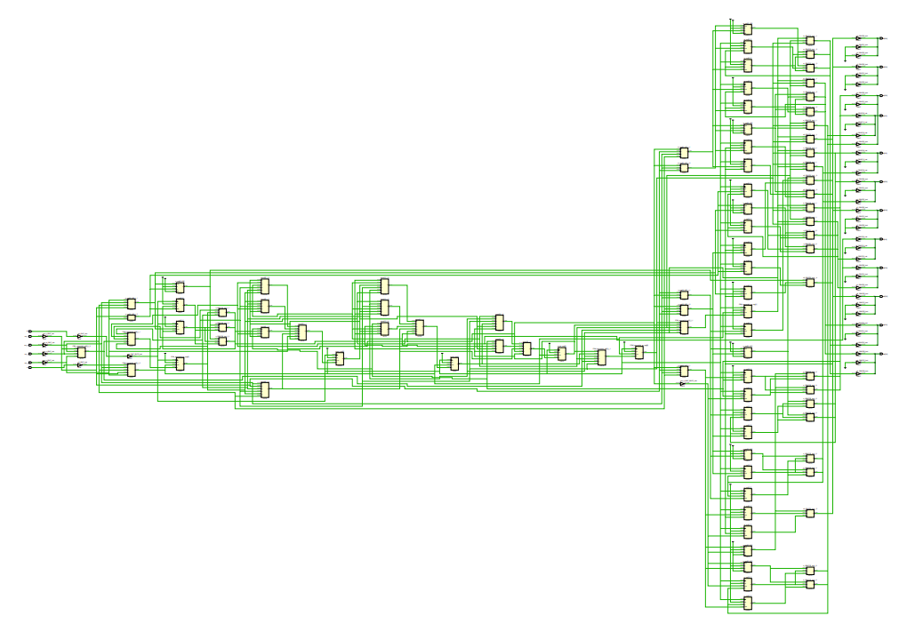
RTL Schematic:

Slide 10
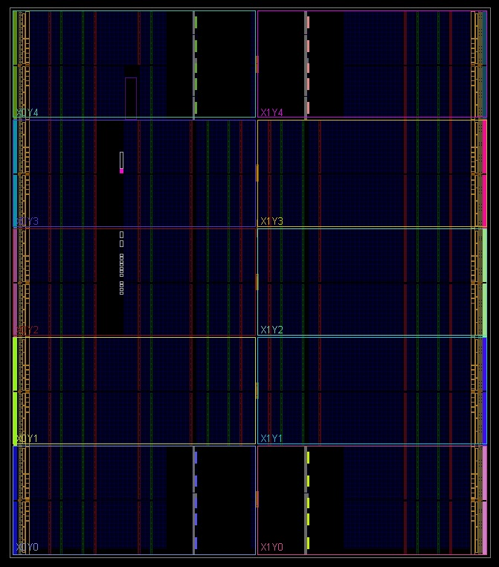
Device layout of the system:

Slide 11
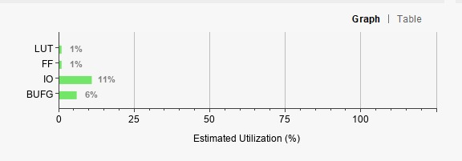
Utilization Report:
Num of cells occupied: 135 cells

Slide 12
References:
[1] K. S. Reddy and B. B. Shabarinath, "Timing and Synchronization for Explicit FSM Based Traffic Light Controller," 2017 IEEE 7th International Advance Computing Conference (IACC), 2017, pp. 526-529, doi: 10.1109/IACC.2017.0114.
[2] B. K. Koay and M. M. Isa, "Traffic light system design on FPGA," 2009 IEEE Student Conference on Research and Development (SCOReD), 2009, pp. 269-271, doi: 10.1109/SCORED.2009.5443035.

